Slide 1

Trudeau Theatrical Tours
Presents…
Cruising the Adriatic and
the Dalmatian Coasts
2020 Departure Date: July 29 – August 8

Slide 2
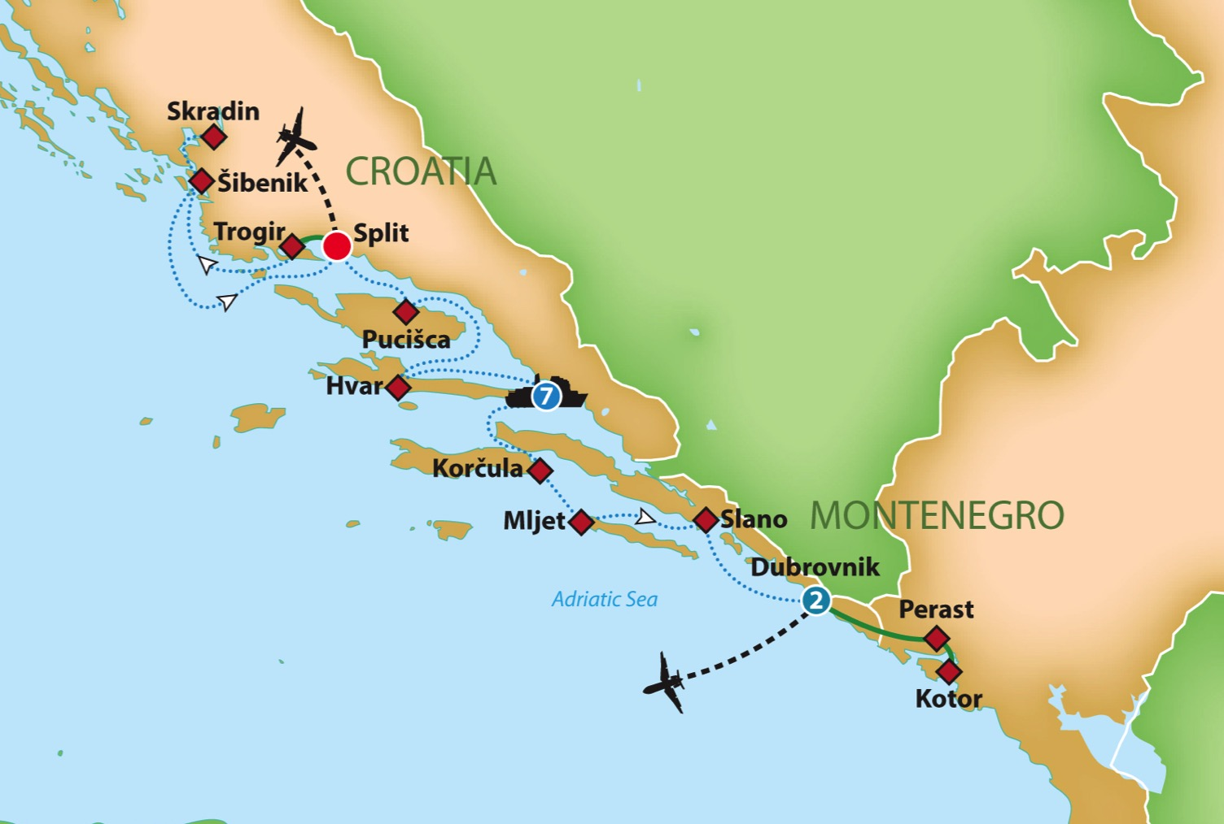

Cruising the Adriatic and Dalmatian Coasts
11 Days • 18 Meals

Slide 3
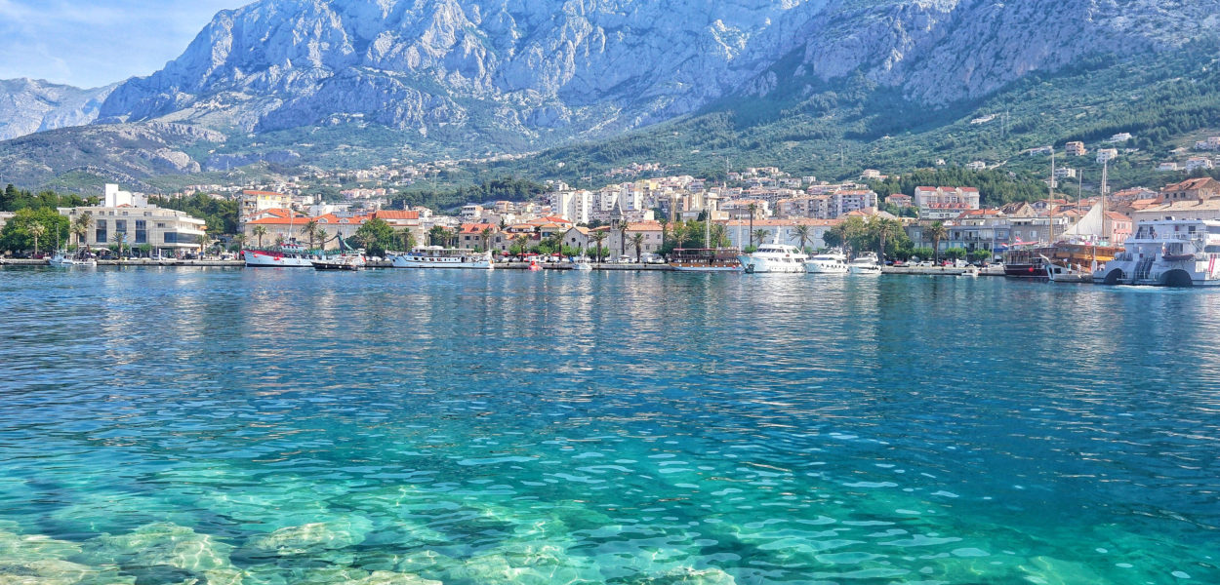
Live the life of the rich and famous and join us on a private yacht as we embark on an 11 day adventure cruising the Adriatic and Dalmatian Coasts.
Experience the history, culture, food, and architecture of the old-world eastern European coast, combined with amazingly blue seas and thick forests. Exploration and relaxation make the perfect vacation!

Slide 4
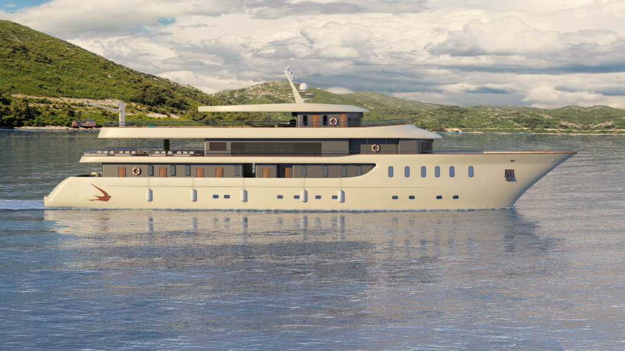
Cruising the Adriatic and Dalmatian Coasts
M/S Sea Swallow 2
Brand new Ship! Built in 2020
34 Guests with 17 cabins
160 feet long/28 feet wide
4 decks
VIP Salon with 180 degree lounge area

Slide 5

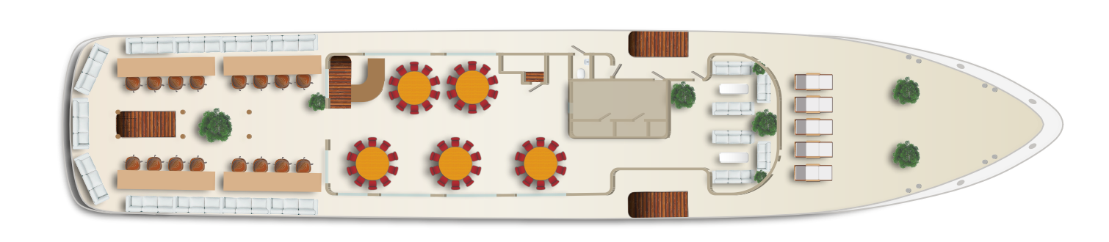
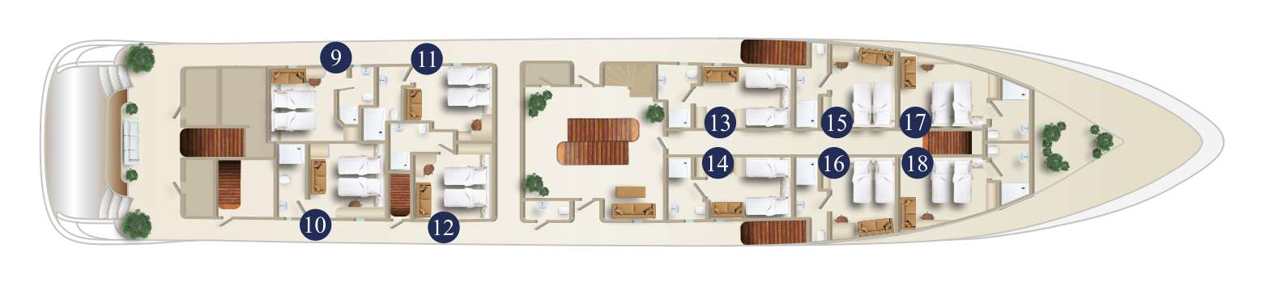
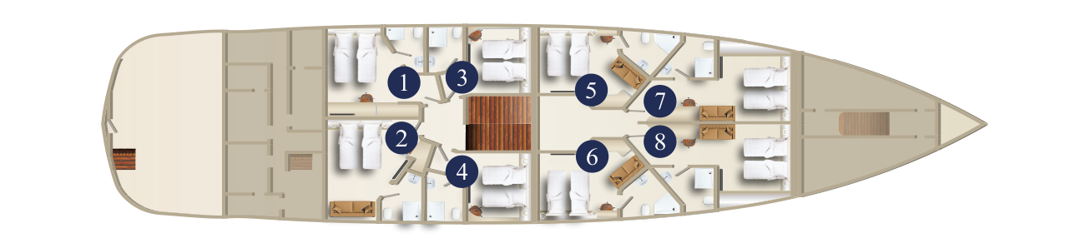
M/S Sea Swallow 2
Sunny Deck
v
Sun Deck with sun loungers and jacuzzi
Upper Deck
Salon-Restaurant with bar and lounge area
In the front: VIP Saloon with lounge area
Main Deck
Swimming Platform and cabins
Lower Deck
Cabins

Slide 6
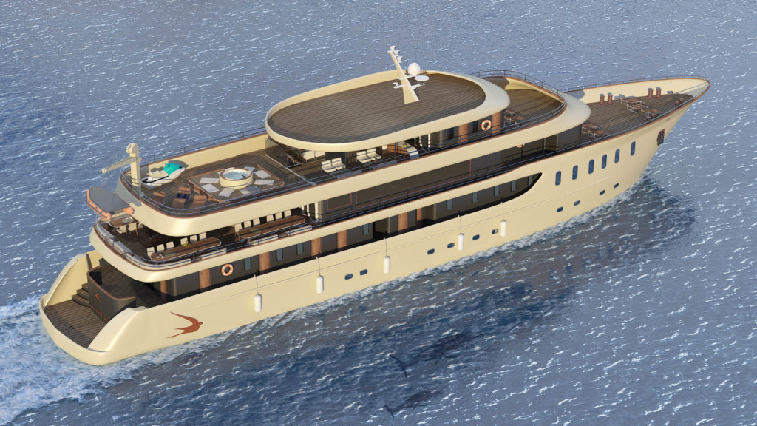
Cruising the Adriatic and Dalmatian Coasts
M/S Sea Swallow 2

Slide 7
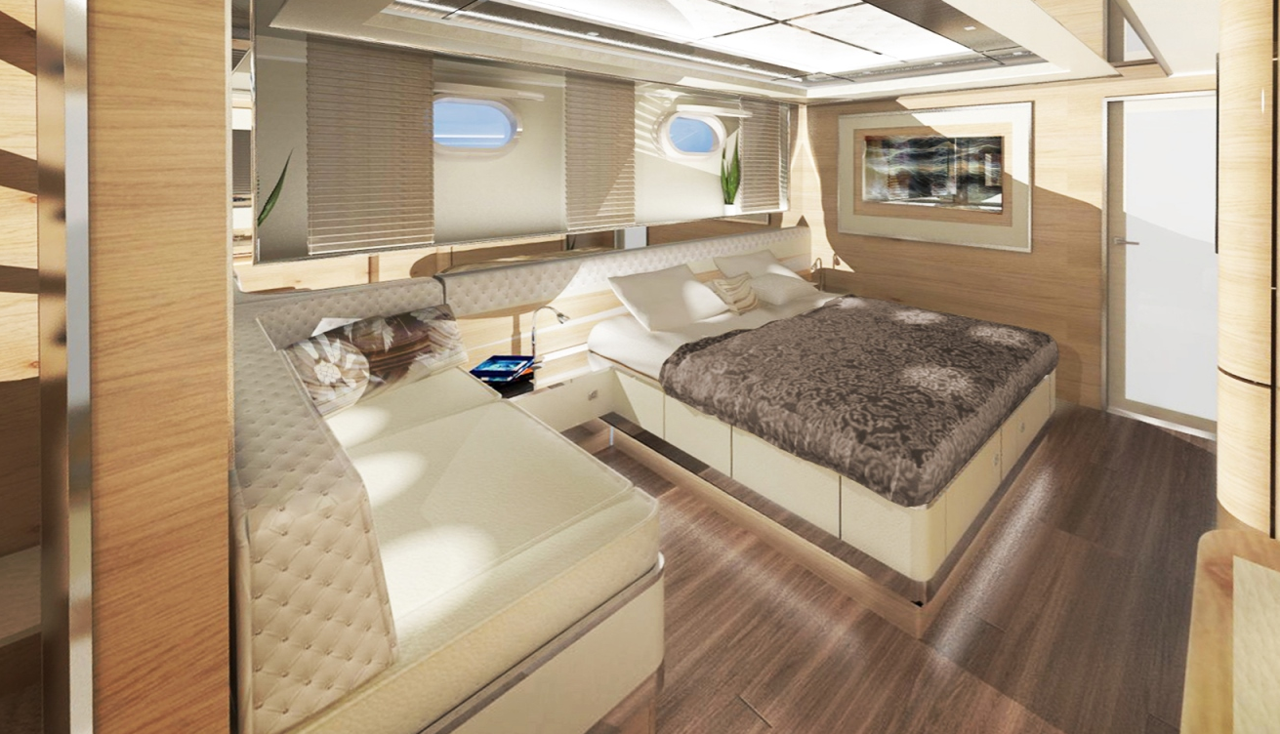
Cruising the Adriatic and Dalmatian Coasts
All cabins are equipped with:
En-suite bathroom
Air-conditioning
Toiletries
Sat TV
Hair dryer
Wi-Fi
Luggage space under the bed
Wardrobe
Towels for swim stops

Slide 8
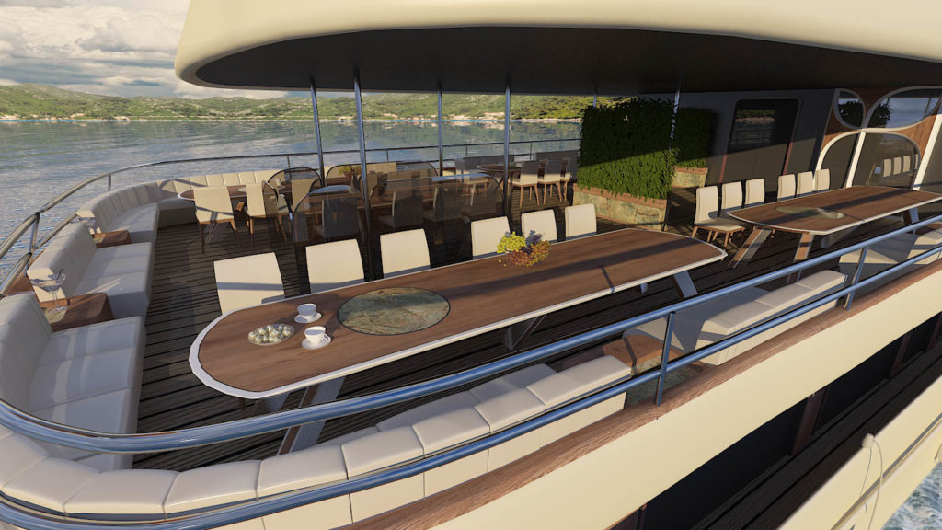
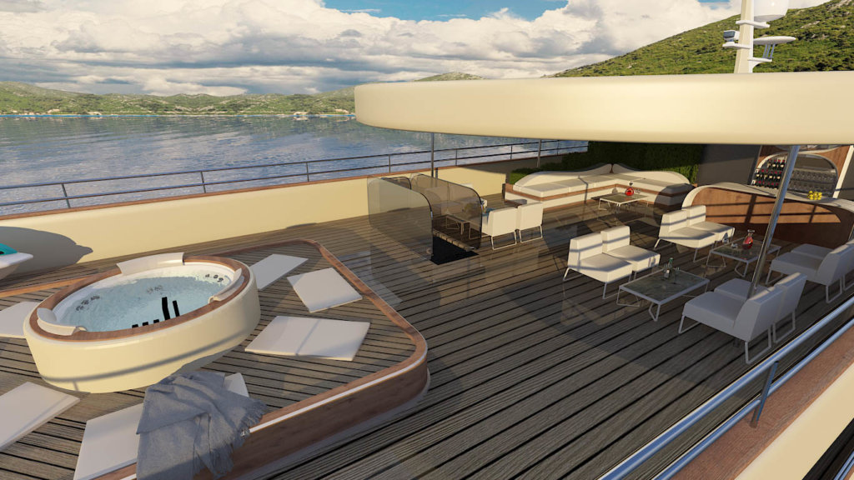
Cruising the Adriatic and Dalmatian Coasts
Upper deck restaurant, bar
Outdoor seating area with Jacuzzi.
M/S Sea Swallow 2

Slide 9
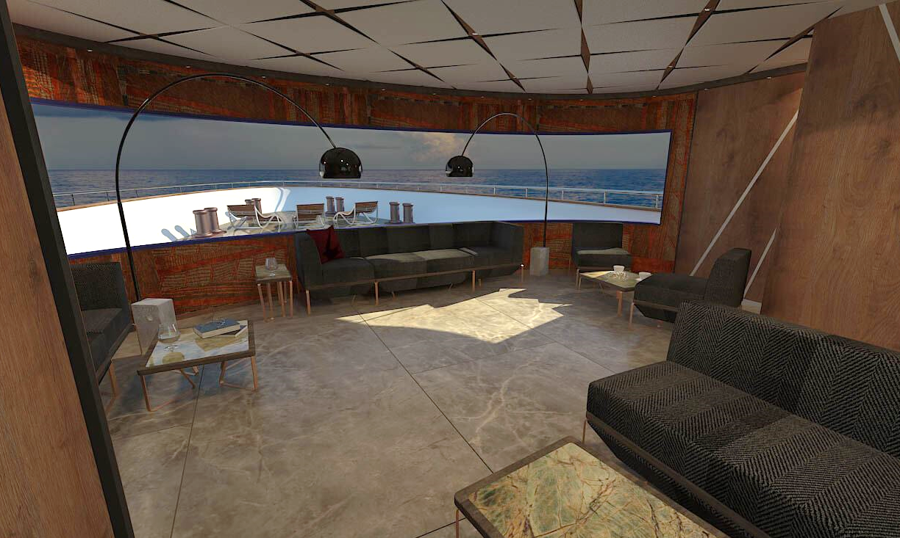
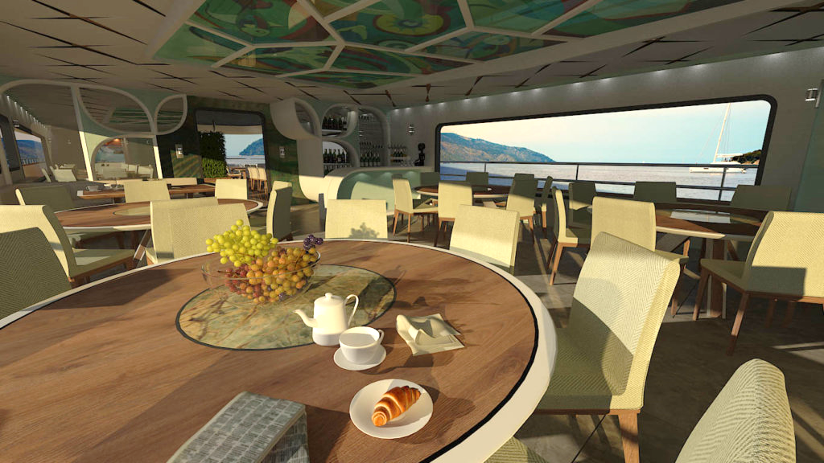
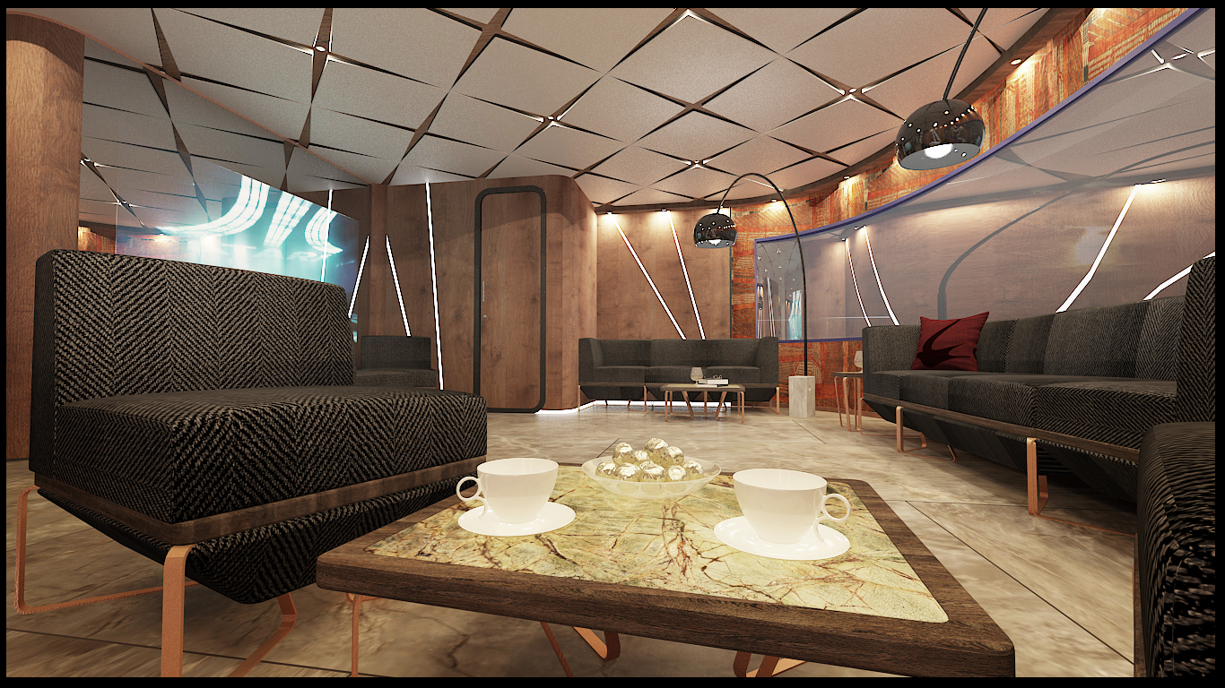
Cruising the Adriatic and Dalmatian Coasts
Restaurant, 180 degree lounge area
M/S Sea Swallow 2

Slide 10
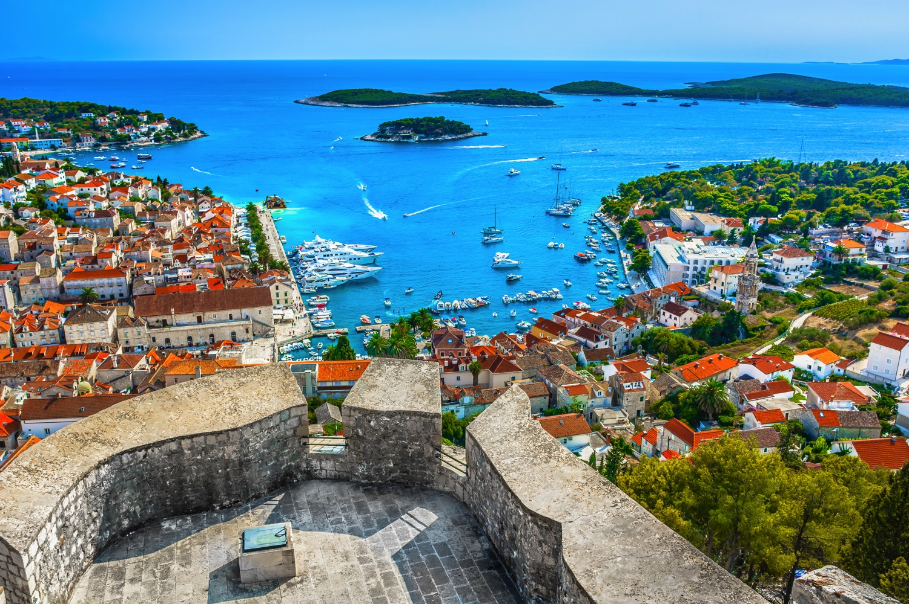
Cruising the Adriatic and Dalmatian Coasts
Hvar, Croatia

Slide 11
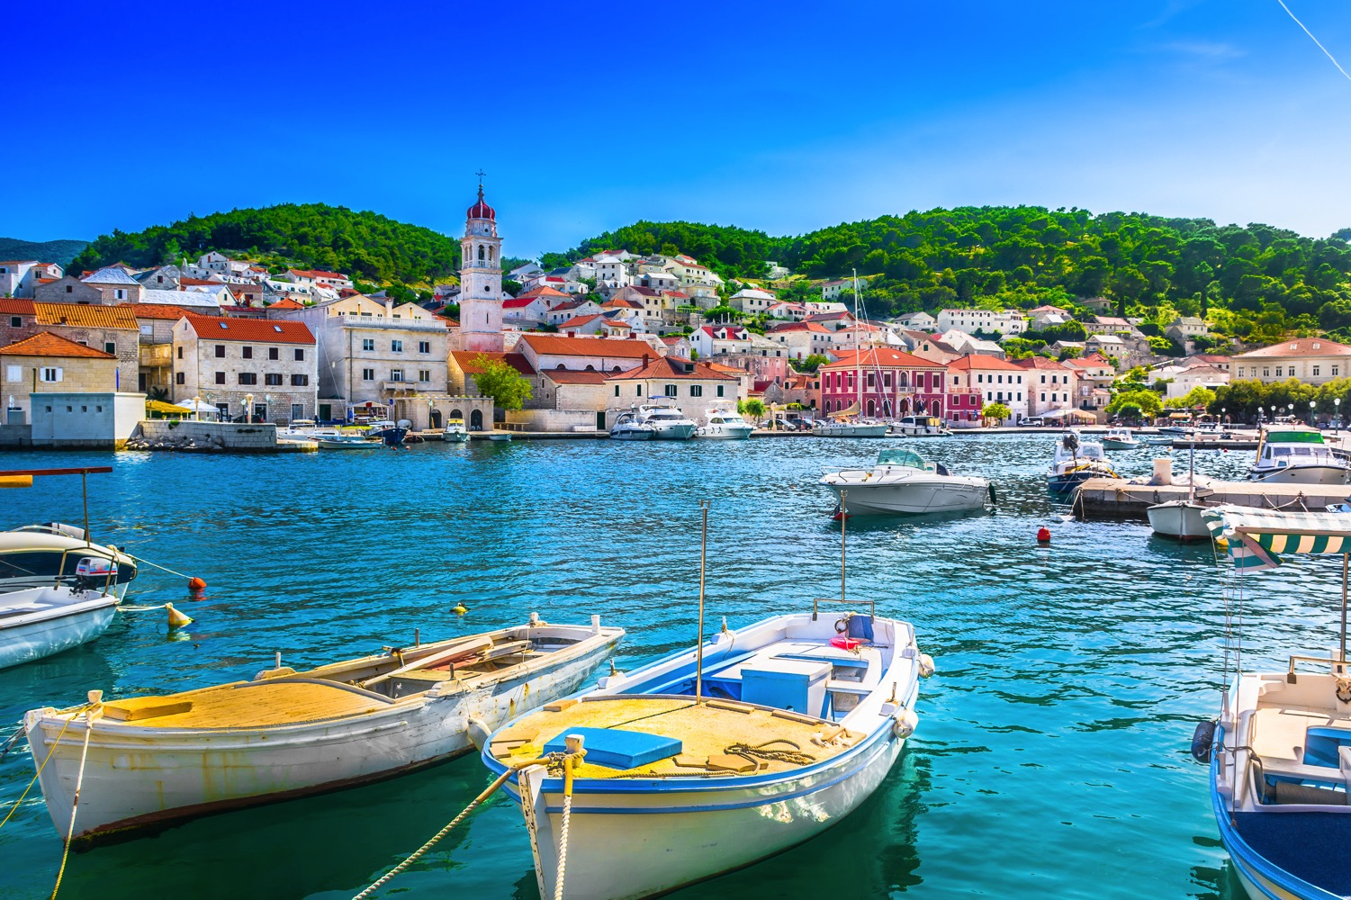
Cruising the Adriatic and Dalmatian Coasts
Pucisca, Croatia

Slide 12
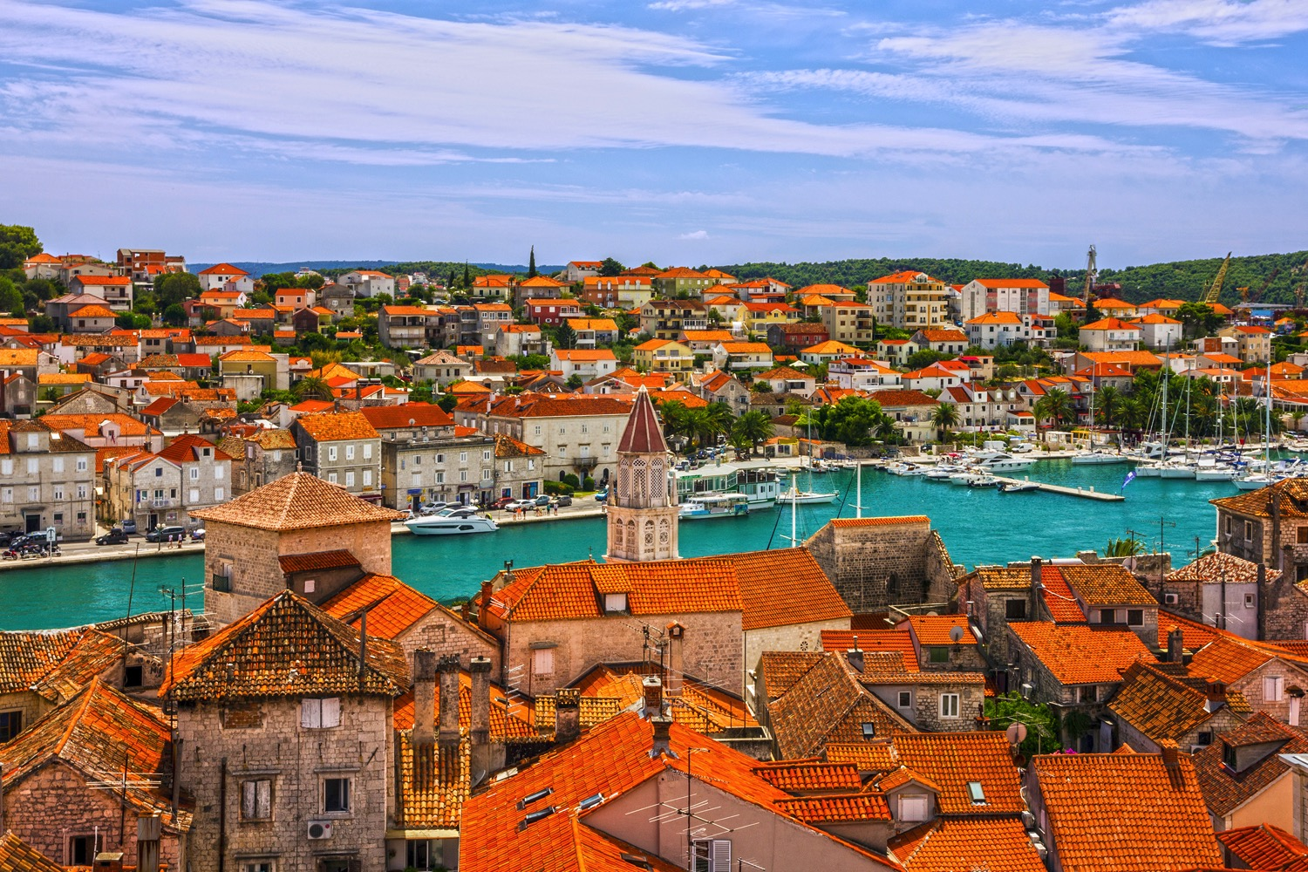
Cruising the Adriatic and Dalmatian Coasts
Trogir, Croatia

Slide 13
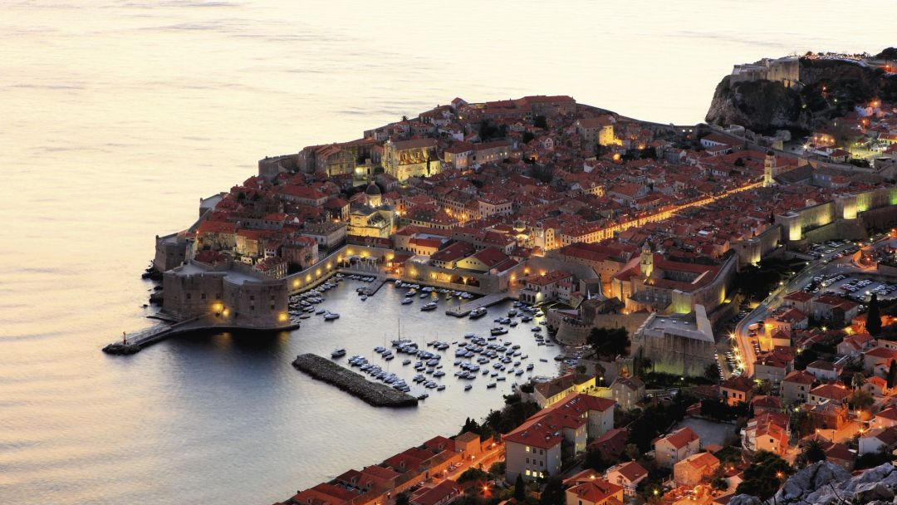
Cruising the Adriatic and Dalmatian Coasts
You are receiving this invitation because you are among my most loyal travelers. There are a limited number of cabins and reservations will be on a first come first serve basis. This has not been sent out to the masses, only a select few. Please use discretion when discussing this opportunity with others.
Exclusive Invite

Slide 14
Cruising the Adriatic and Dalmatian Coasts
If you are interested, please rsvp using the enclosed invitation. You will be invited to attend a private presentation with a date to be announced in May.
Trudeau Theatrical Tours
Name:_________________________
Number interested in attending the meeting in :______
I am not local and cannot attend a meeting, but am interested in the trip. Please send me all details:_____
I am not interested, but thanks:_____
RSVP

